Slide 1



Galaxy Morphology of PEARLSDG
Noah McLeod
Mentor: Timothy Carleton
School of Earth and Space Exploration at ASU
April 20th 2024

Slide 2
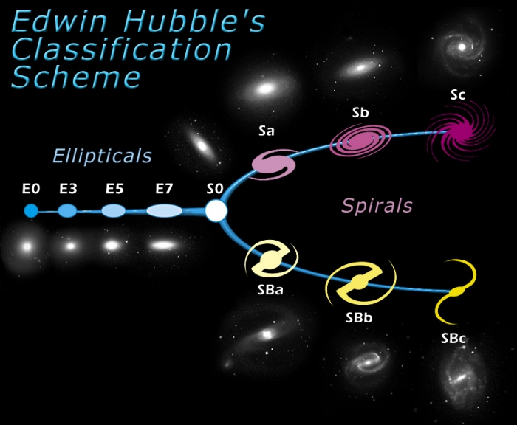
Galaxy Morphology
Logical ways to classify galaxies
Insight into how galaxies evolve
Credit: STSI

Slide 3
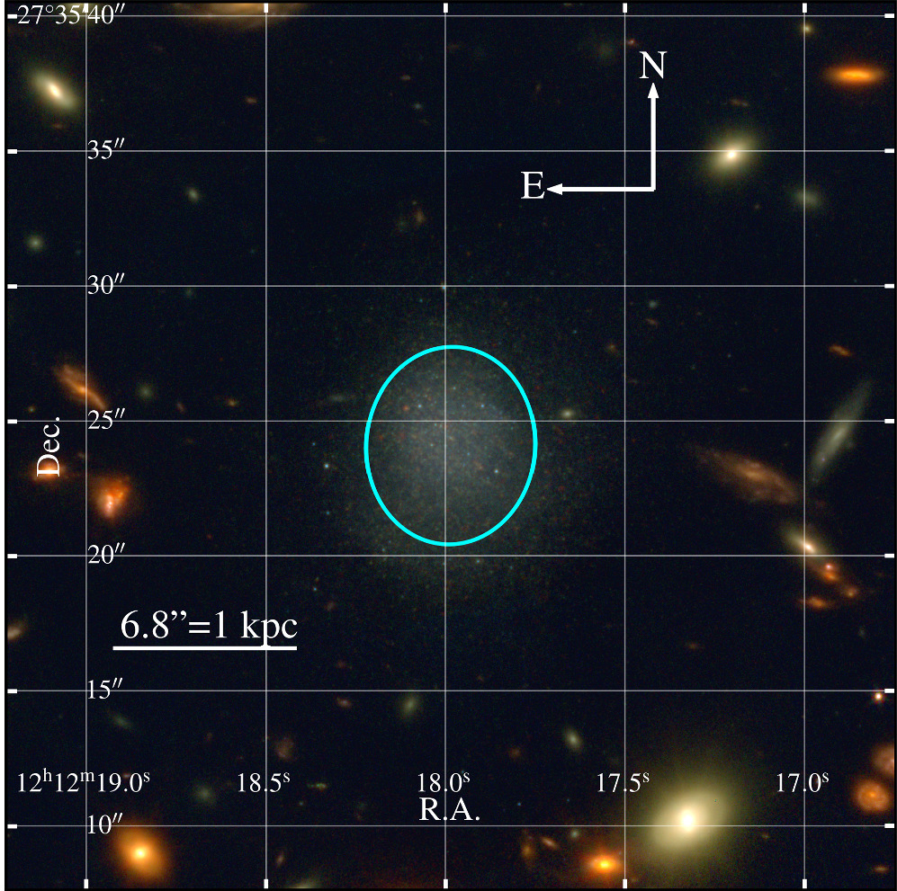
PEARLSDG
Isolated quiescent dwarf galaxy with a remarkably low star formation rate
CLG1212 cluster, R.A. = 12h12m18s, decl. = +27d35m24s, 30 ± 4 Mpc.
Timothy Carleton et al 2024 ApJL 961 L37

Slide 4
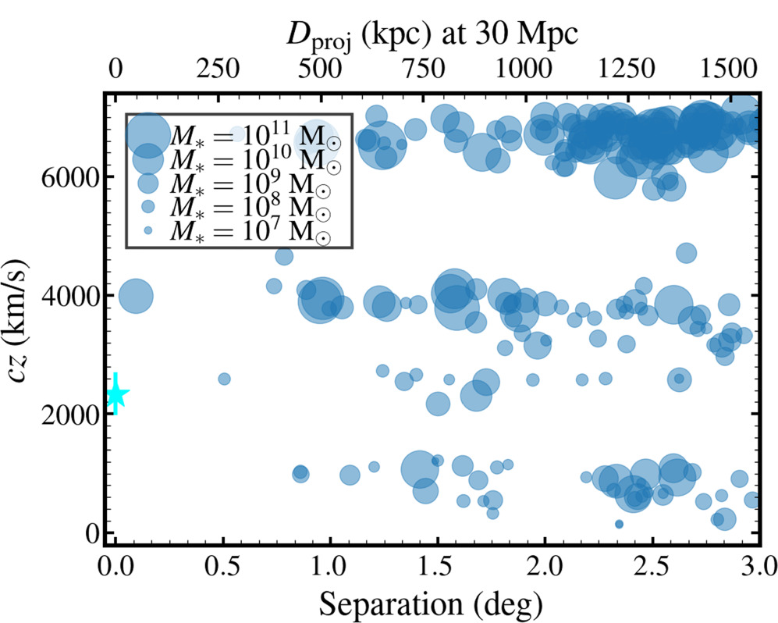
Motivation
PEARLSDG is uncharacteristic due to its quiescence and isolation.
Compare morphological parameters to other dwarf irregulars
The location of nearby galaxies with respect to PEARLSDG (cyan star)
Credit: Timothy Carleton et al 2024 ApJL 961 L37

Slide 5
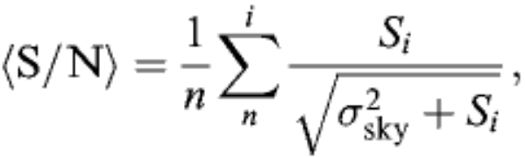

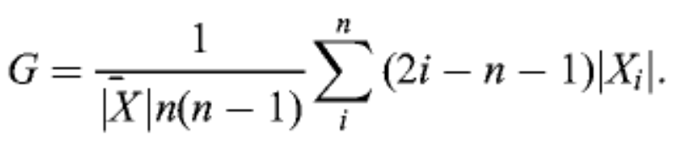

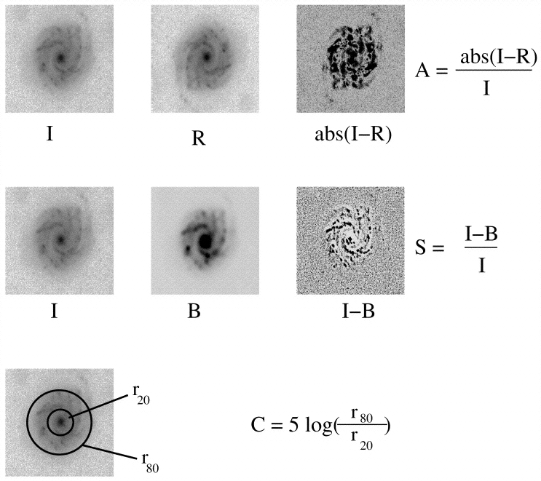



Methods
Utilize Source Extractor¹ to background substitute images.
Use Statmorph² to calculate morphological parameters
Concentration, Asymmetry, Smoothness (CAS)
Gini-coefficient, M₂₀ for (S/N) ≥ 2
Signal-to-noise ratio
Gini-Coefficient M₂₀
Concentration Asymmetry Smoothness
Conselice et al (2003)
Bertin, E. and Arnouts, S. (1996)
Rodriguez-Gomez et al. (2019)

Slide 6
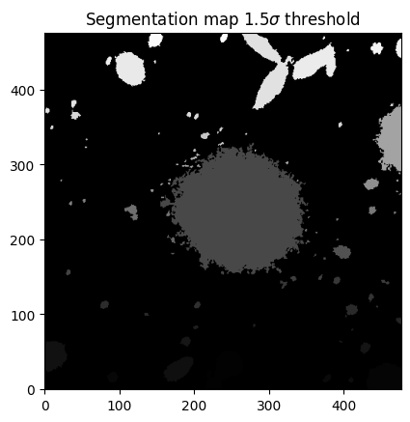
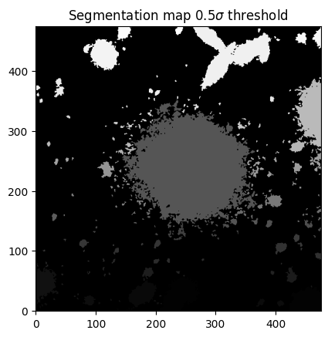
Methods Cont.

Slide 7
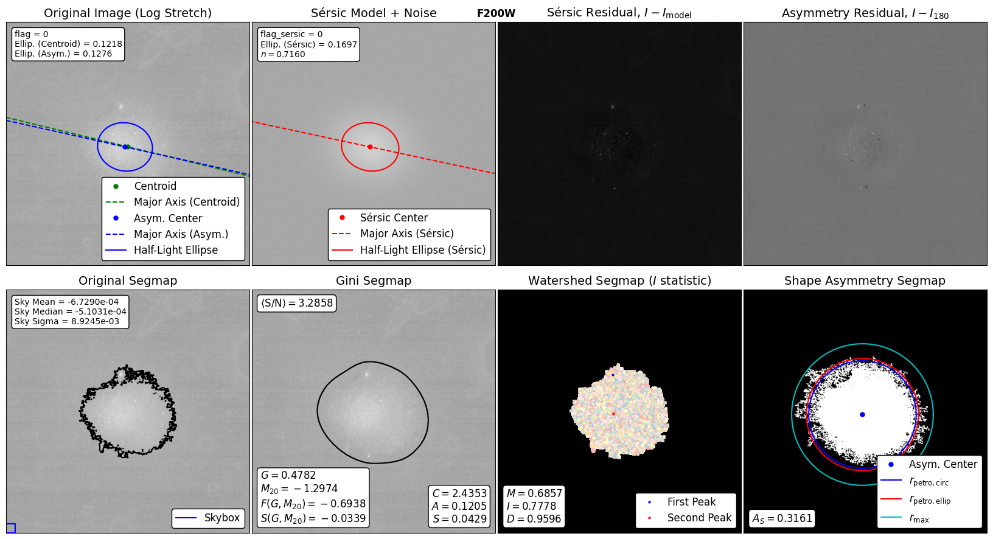
Results
F200W at 1.5σ threshold
Concentration: 2.43
Asymmetry: 0.12
Smoothness: 0.04
Some of the morphological measurements performed by Statmorph. The mathematical methods of calculating parameters produced can be found in Rodriguez-Gomez et al. (2019). Top left: cut out from the original galaxy image. The blue (green) point minimizes asymmetry (centroid), the blue lines indicate the orientation and half of the total flux. Top, second from left: The fitted Sersic model, with n as the Sersic index. Top, second from right: The residual generated by subtracting the model from the original image. Top right: the residual image, the rotated image subtracted from the original. Bottom left: The original image with a black contour indicating the galaxy identified by the segmentation map. Bottom second from left: Image with black contour indicating the pixels used in the Gini-M20 quantities, as well as the CAS statistics. Bottom, second from right: A watershed segmentation map, the colors indicate pixels associated with each local maximum, and the MID statistics are provided. Bottom right: The detection mask used to calculate the shape asymmetry. The cyan circle shows the minimum circle enclosed in the mask.

Slide 8
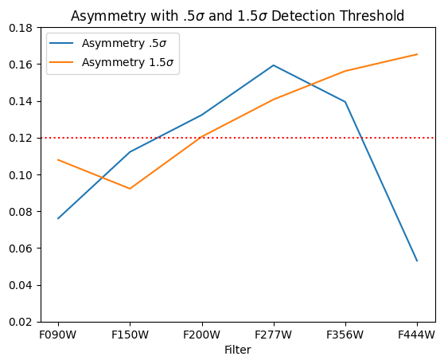
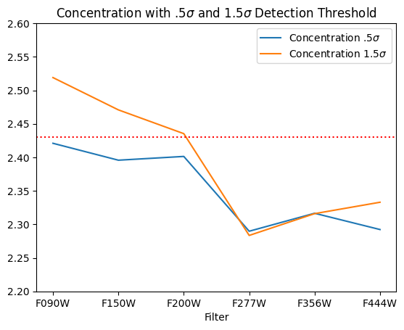
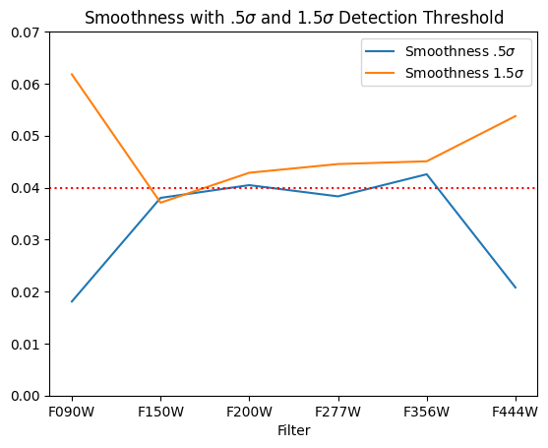
Results Cont.
Compare measured CAS values between two different detection thresholds
Fairly consistent in middle filters

Slide 9
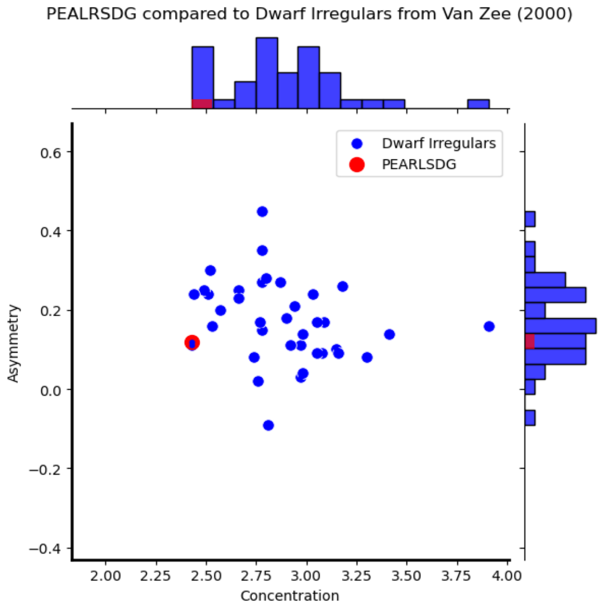
Comparison to Van Zee (2000)
37 dwarf irregulars
Late-type galaxies with M_{b} > -18
A = 0.17 ± .10, C = 2.9 ± 0.3

Slide 10
Conclusions
CAS parameters of PEALRSDG consistent with other irregular dwarf galaxies
Concentration: 2.43, Asymmetry: 0.12, Smoothness: 0.04
Although PEARLSDG is quite isolated, it’s morphology could be indicative of internal, or external mechanisms, like past interactions, or dark matter
Low star formation rate in dwarf galaxies can be evidence of tidal stripping
While external interaction is not ruled out, PEARLSDG distance from other galaxies raises questions about other mechanisms that affect morphology and SFR

Slide 11
Acknowledgments
Dr. Timothy Carleton
Dr. Rogier Windhorst, Dr. Seth Cohen, Dr. Rolf Jansen
Desiree Crawl and ASU/NASA Space Grant team
PEARLS and School of Earth and Space Exploration
JWST

Slide 12
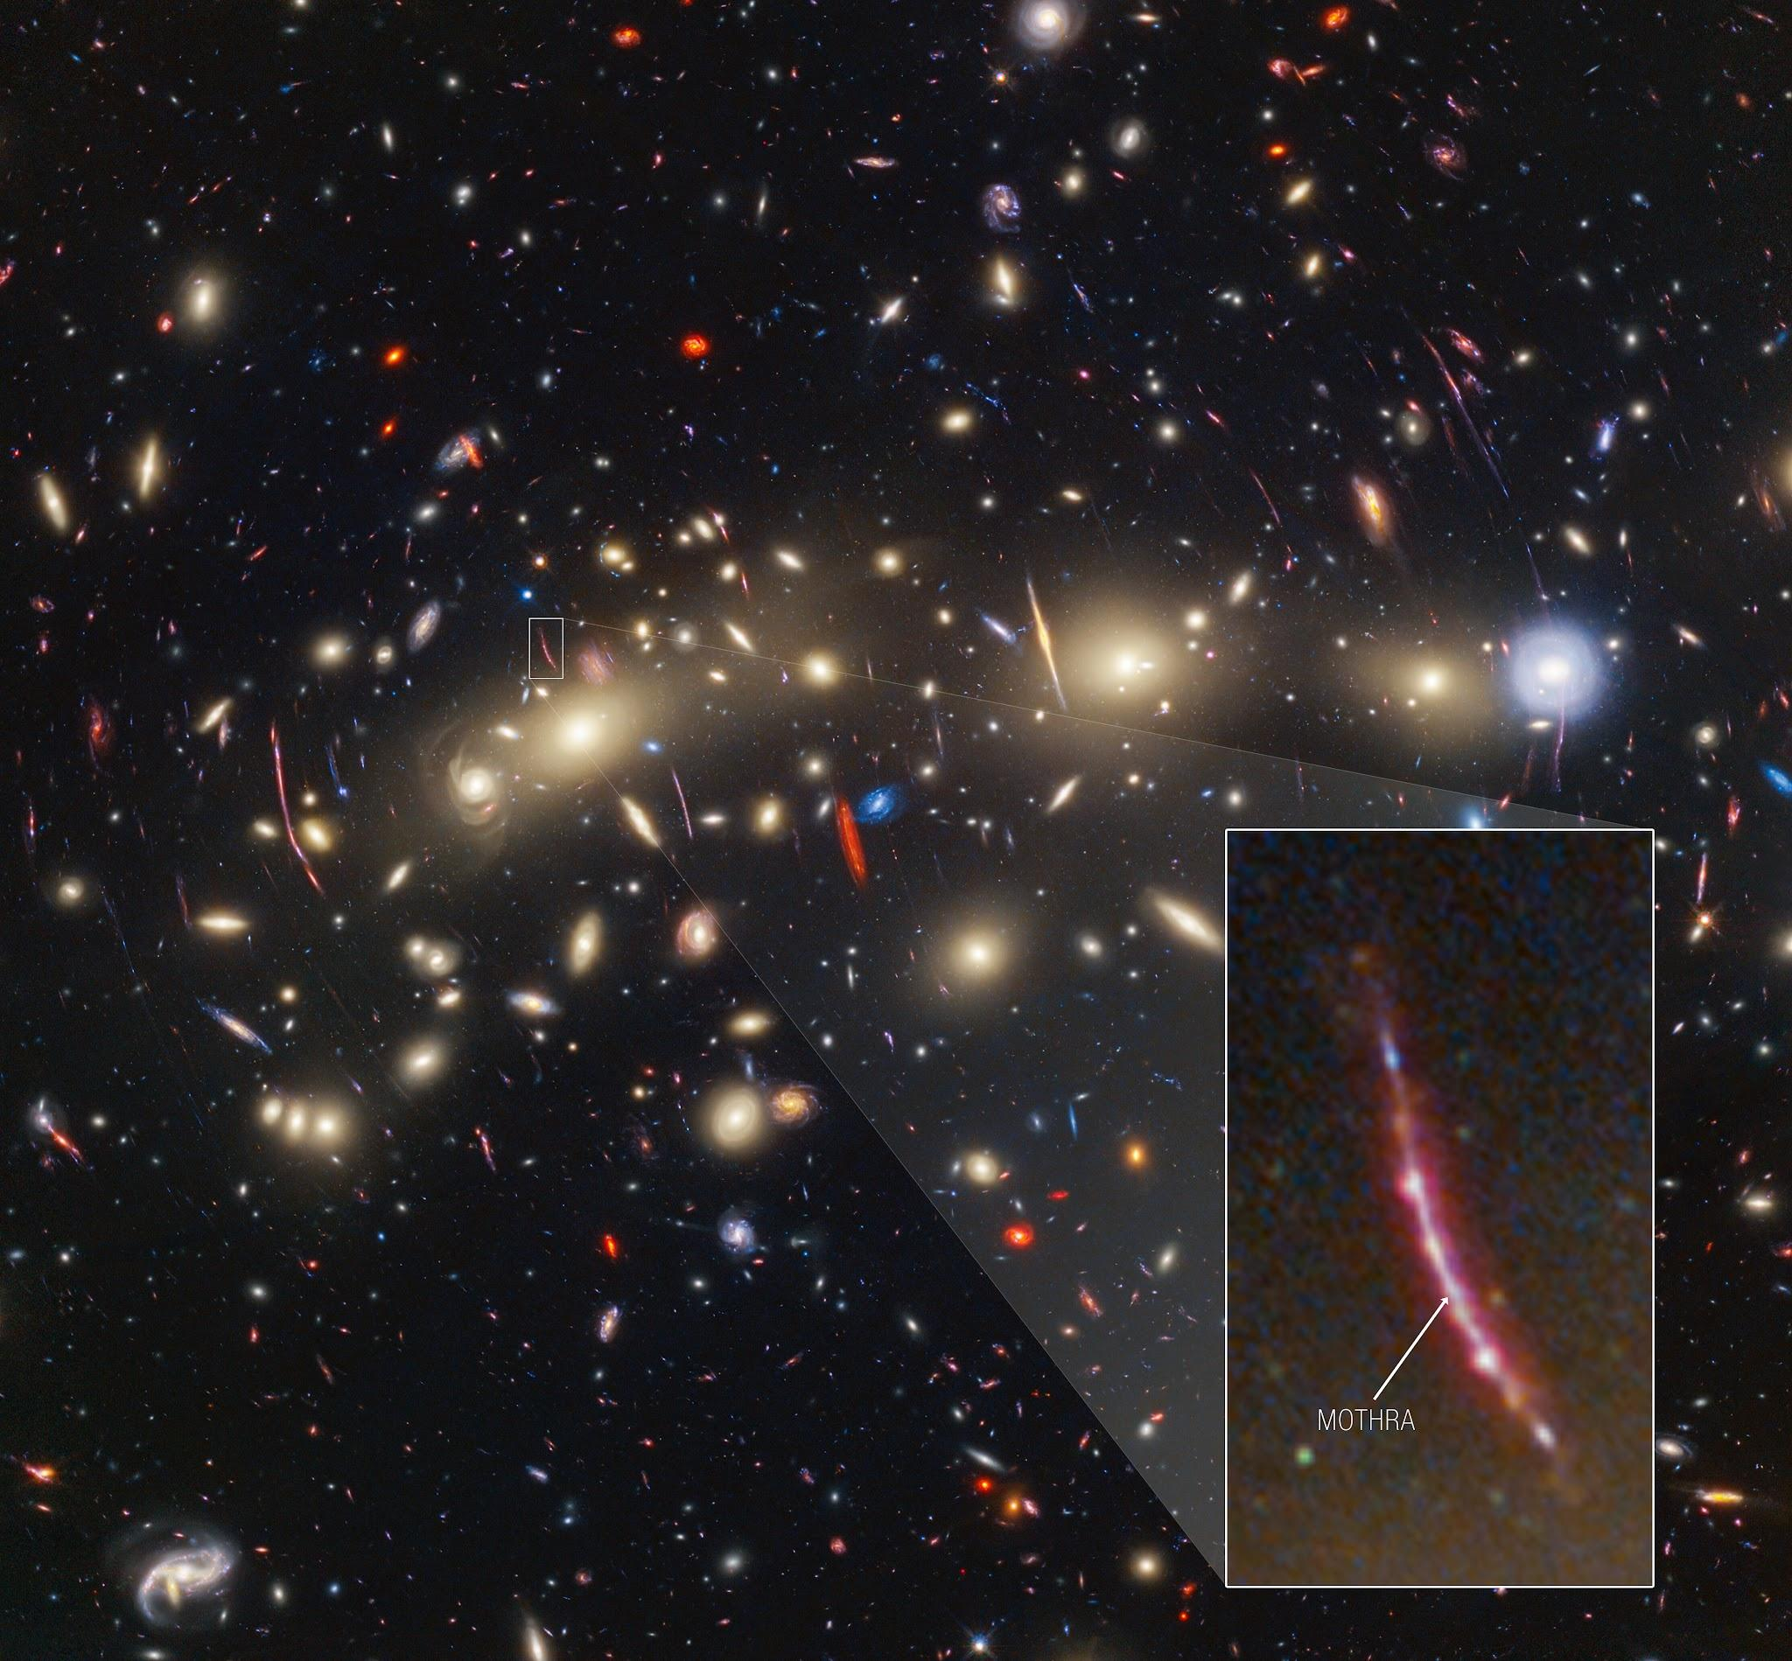
Thank you!

